Slide 1
Defining the Landscape of HLA Risk Alleles in Primary Nephrotic Syndrome and Post Kidney Transplant Recurrence 1U01AI152585-01
Rasheed Gbadegesin, MBBS, MD
Annette Jackson, PhD
4/5/2021
Notes:
<number>

Slide 2
Disclosure
We have no conflict of interest associated with this talk

Slide 3

BACKGROUND
Childhood nephrotic syndrome (NS) is a rare immune-mediated kidney disease
Prevalence:16/100,000 children
NS classification: Initial response to corticosteroid RX
Steroid sensitive nephrotic syndrome (SSNS 80% ~MCD)
Steroid resistant nephrotic syndrome (SRNS 20% ~FSGS)
SRNS major cause of CKD/ESKD (Cost/year $120B)
Available treatment unsatisfactory
Recurrence post transplant major cause of kidney allograft failure
Notes:
<number>

Slide 4
BACKGROUND
Pathogenesis not completely known
Evidence converge on common theme of T and B lymphocytes dysregulation
Alterations in T lymphocyte subsets during relapse of NS
Induction of remission by infections that can suppress T lymphocytes
Therapeutic agents used in RX are modulators of T cell function
B cells: B cell depletion with rituximab (monoclonal antibody against CD20 on B lymphocytes) can induce NS remission
HLA is essential in facilitating T and B lymphocyte interactions and may be an important mechanistic link in the pathogenesis of NS
Recent GWAS identified variants in HLA genes as risk loci for NS

Slide 5
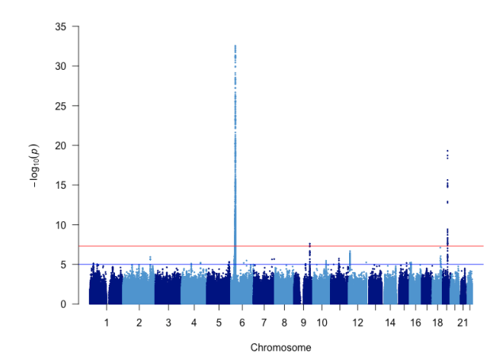
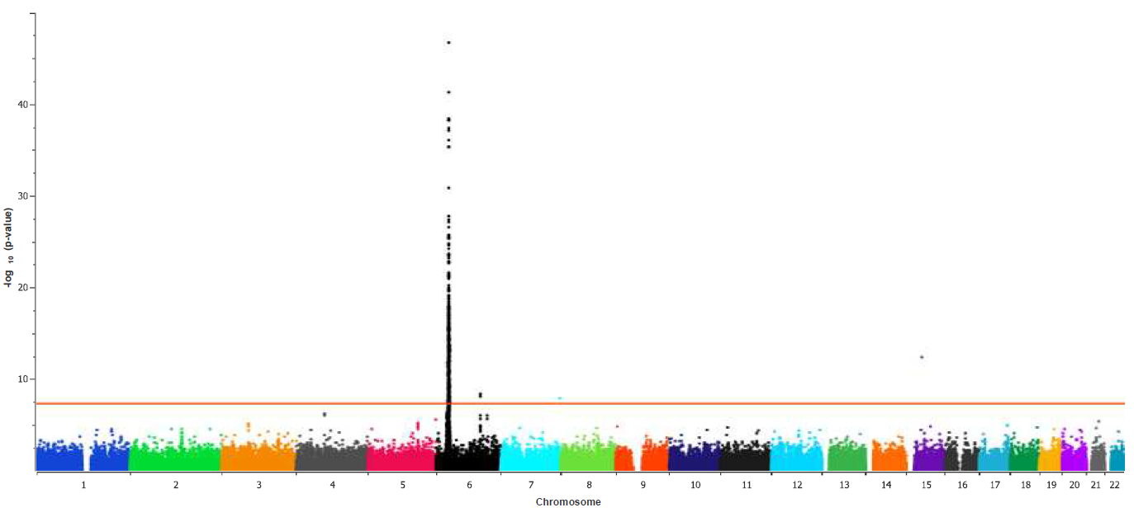
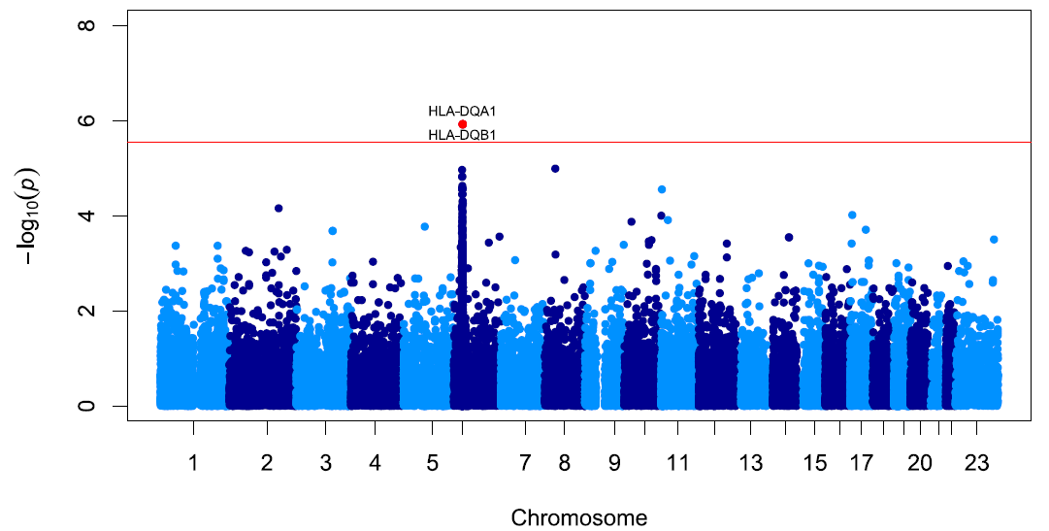
BACKGROUND
GWAS findings emphasize the role of adaptive immunity in the pathogenesis of SSNS
Gbadegesin et al JASN 2015
Population: South Asian, N: 214
Loci: HLA-DQA1, HLA-DQB1
Dufek et al JASN 2019
Population: European, N: 422
Loci: HLA-DR/DQ, CALHM6
Jia et al KI 2020
Population: Japanese, N: 987
Loci: HLA-DR/DQ, NPHS1-KIRREL2, TNFS15

Slide 6
BACKGROUND
Limitations of current GWAS studies
GWAS chips unable to infer precise allelic association because of high levels of polymorphism, gene duplications, and high levels of LD in HLA region
Use of small mono-ethnic cohorts in the majority of studies
Exclusion of children with SRNS
The HLA loci identified account for a very small % of the disease phenotype: there are other disease loci in and outside of the HLA genes yet to be identified
Deep NGS sequencing of all 11 HLA genes in a multiethnic cohort will identify new haplotypes and determine shared regulatory motifs that provide insight to molecular mechanisms.

Slide 7
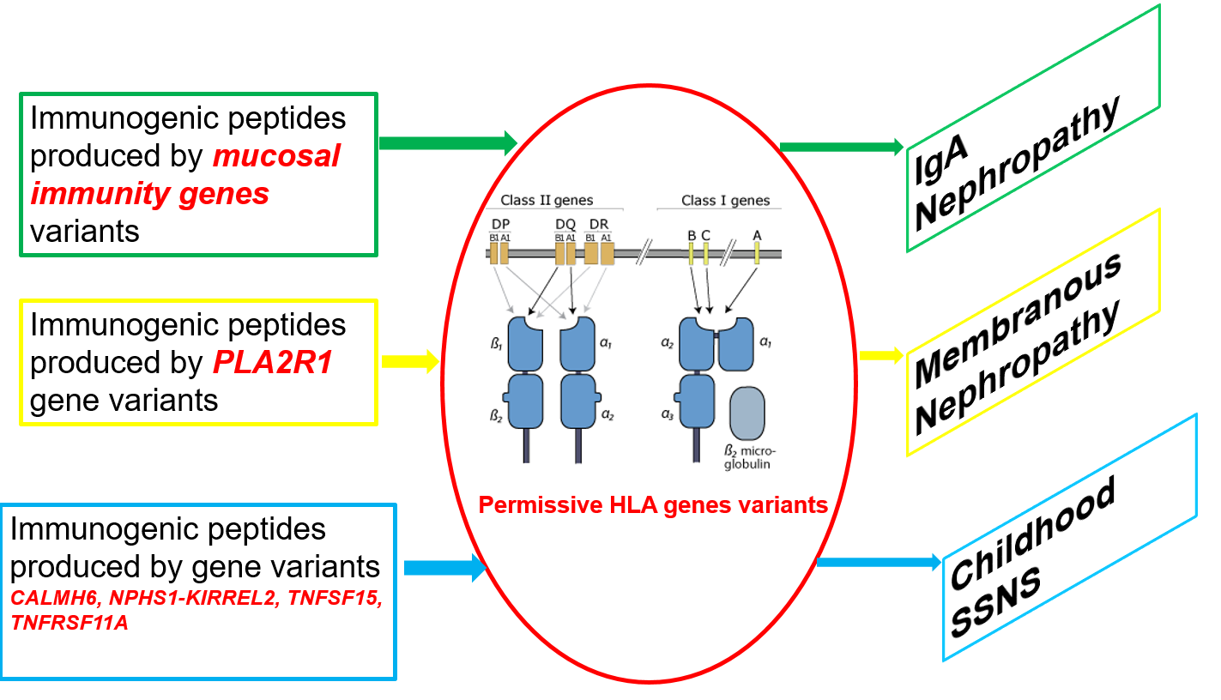
BACKGROUND
HLA region pleotropic for multiple immune mediated glomerular diseases (GD) that can cause secondary NS
Multiple HLA genes loci associated with IgAN and MN (2⁰ NS)
Both 1⁰ & 2⁰ NS associated with loci outside of HLA region
Unified disease model for GD: At least 2 genetic hits

Slide 8
BACKGROUND
Incomplete coverage of the HLA regions by GWAS preclude understanding of overlap between 1⁰ & 2⁰ NS
Defining the HLA risk overlap may lead to ID of unified pathways important in the pathogenesis of 1⁰ & 2⁰ NS
Unclear if haplotype driven HLA expression in immune cells and kidney underlies disease mechanisms
The role of NS HLA alleles/haplotypes in NS recurrence following kidney transplantation unknown

Slide 9
PROJECT GOALS
Broad hypothesis: Certain HLA alleles/haplotypes associated with NS can predict pattern of corticosteroid response in NS and risk of disease recurrence following kidney transplantation

Slide 10
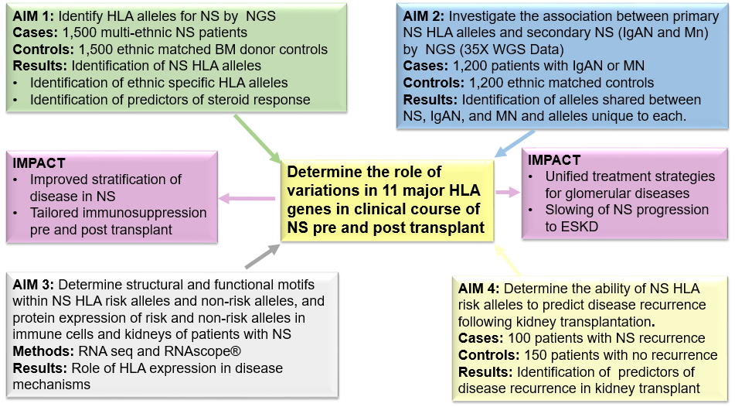
PROJECT GOALS

Slide 11
SUMMARY OF EXPERIMENTS
Aim 1: Identify NS HLA risk alleles/haplotypes using high resolution HLA gene sequencing in a cohort of multi-ethnic patients and determine the relationship between genotypes and therapy response
Approach
NGS of the 11 major HLA genes and additional MHC genes using an innovative, high throughput typing strategy that utilizes hybrid probe capture technology (CareDx, Brisbane CA) on 1,500 patients with NS and 1,500 ancestry matched controls.
Replicate the top 20 variants identified in this aim in the 35x whole genome sequencing (WGS) data from the 1,200 patients and controls with MCD or FSGS enrolled in the CureGN Study
Expected outcomes
Identification of new HLA risk alleles/haplotypes for NS in a large multi-ethnic cohort of patients with NS and confirmation of previously reported HLA loci.
Identification of ancestry specific loci.
Identification of variants that predict pattern of response to corticosteroids.

Slide 12
SUMMARY OF EXPERIMENTS
Aim 2: Investigate the association between primary NS HLA risk alleles/haplotypes and secondary causes of immune-mediated NS, such as IgA and membranous nephropathy.
Approach
HLA typing of 1,200 patients with IgAN or MN and ancestry controls from the CureGN study for which 35X WGS is available
We will compare allele frequency of variants that are significant in Aim 1 (Primary NS) in 1,200 patients with IgA or MN and controls
Expected outcomes
Confirmation of HLA loci previously associated with IgAN and MN and identification of new disease loci.
Identification of alleles shared between primary NS, IgAN, and MN and alleles unique to each group.

Slide 13
SUMMARY OF EXPERIMENTS
Aim 3: Determine common structural and functional motifs within NS HLA risk alleles/haplotypes and non-risk alleles by in-silico modeling and compare gene and protein expression of these alleles in B lymphocytes and kidneys of patients with primary NS
Approach
Evaluate the structural, functional and peptide binding differences between risk and non-risk alleles by in-silico modeling tools: (I-TASSER server, PolyPhen, Sift, MutationTaster) and epitope binding: IEDB T Cell Epitope Prediction Tools
Examine HLA gene expression, surface protein expression, and intrarenal expression by bulk RNAseq, and flowcytometry in lymphocyte and kidney biopsy samples obtained from patients with high and low risk haplotypes during relapse and remission of NS
Expected outcomes
NS HLA risk alleles will exhibit higher HLA gene and/or protein expression during relapse than non-risk alleles
SSNS patients, who respond to corticosteroid treatment, will have decreased HLA expression at time of remission
Differential expression of HLA will provide direct evidence for an HLA intrinsic role in NS and RNAScope® intrarenal cell-specific HLA expression patterns will focus and inform our understanding of NS pathways

Slide 14
SUMMARY OF EXPERIMENTS
Aim 4: Determine the ability of known and novel NS HLA risk alleles/haplotypes to predict disease recurrence following kidney transplantation.
Approach
We will determine the association of NS recurrence in kidney transplant in 250 patients with NS who are post transplant with NS HLA risk haplotypes
We will determine whether NS recurrence is increased when donor genotypes include NS HLA risk allele/haplotype
Develop a clinical and genomic prediction model for NS recurrence
Expected outcome
Identification of HLA haplotypes/risk alleles for NS recurrence
Identification of phenotypic and genotypic risk calculator of NS recurrence that will form the basis for risk stratification pre and post-transplantation

Slide 15
DATA COLLECTED AND KEY FINDINGS
Regulatories
IRB approval Duke as a center
IRB in progress Duke as a coordinating center
Case record forms (CRF)
CRF for all studies created and validated

Slide 16
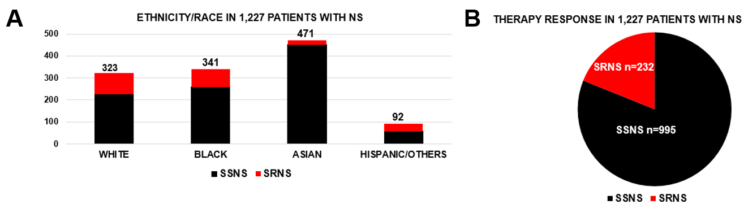
DATA COLLECTED AND KEY FINDINGS
Phenotyping of 1,000+ patients with NS

Slide 17
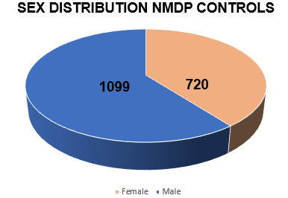
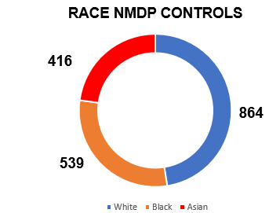
DATA COLLECTED AND KEY FINDINGS
IN-HOUSE CONTROLS
NMDP CONTROLS

Slide 18
KEY ISSUES, CHALLENGES, AND SOLUTION
COVID 19 disruption
Solutions
E-consenting
Engaging more collaborators

Slide 19
MOVING FORWARD
Genotyping of all cases and controls
Start NGS of HLA genes
Ramp up enrollment

Slide 20
AFTERNOON SESSION

Slide 21
GENETIC ANALYSIS
Data:
HLA sequencing for 1500 NS cases, 1500 (BM) controls
Genotyping array data: >1.7 million SNPs
TOPMed Imputation Server
35x WGS, 1200 indiv. from CureGN (IgAN+MN+controls)
Binary traits: NS vs no-NS, SSNS vs SRNS, post-transplant recurrence
Association models for multiethnic (structured) populations:
HapQTL for haplotype association, Mixed-effect model, Firth logistic regression with PCA, LIGERA (developed by Dr. Ochoa)
Condition on known variants, local ancestry
Evaluate test statistic inflation, power, in simulations

Slide 22
GENETIC ANALYSIS
Annotations:
NCBI and ensemble genome browsers
Regulatory regions: ENCODE, RoadMap Epigenomics
Ancestry:
Subanalysis: single-ancestry tests, for identifying weaker ancestry-specific effects
Global ancestry estimation with ALStructure
Efficient Local Ancestry Inference (ELAI)

Slide 23
GENETIC ANALYSIS
Preliminary analysis: 750 SSNS cases only, array
Not imputed (first pass)
Control samples: practically any adults
1000 Genomes Project: WGS, includes Sri Lankan (STU)!
Duke CATHGEN: whole-exome sequencing, greater number of African-American samples
Problem: array bias perfectly confounded with case/control status!
Partial fix: more aggressive filtering, including double Hardy-Weinberg Equilibrium (HWE) test, before and after merging
Plan: Develop a population genetics approach for cross-platform QC

Slide 24
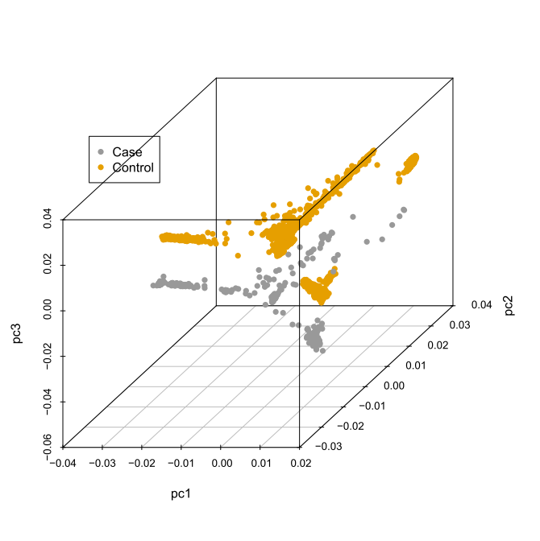
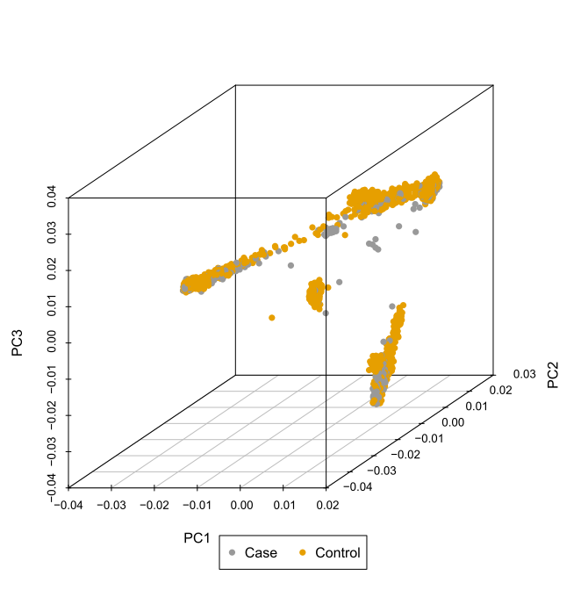
GENETIC ANALYSIS
Array (cases) + 1000 Genomes (controls) simple merge: case/control separation!
Double HWE filter (before and after merge): cases and controls overlap!

Slide 25
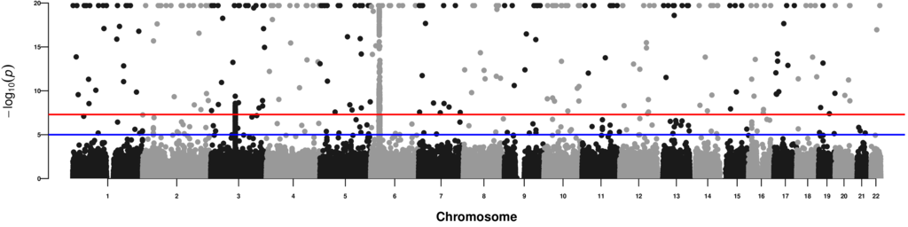
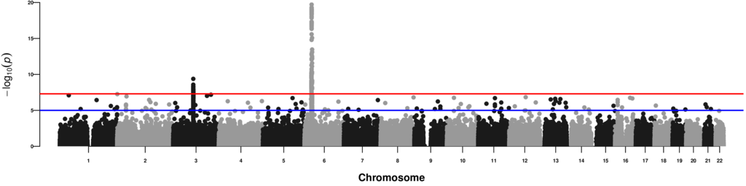
GENETIC ANALYSIS
Top: association statistics remain inflated!
Bottom: significant cases without significant neighbors removed (false positives)

Slide 26
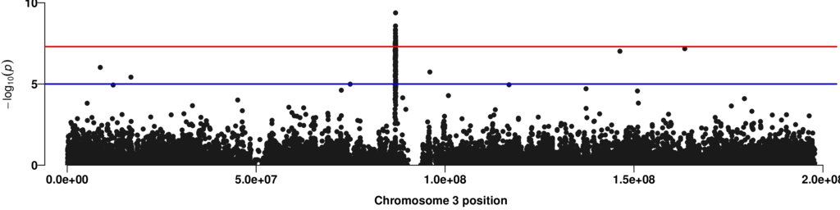
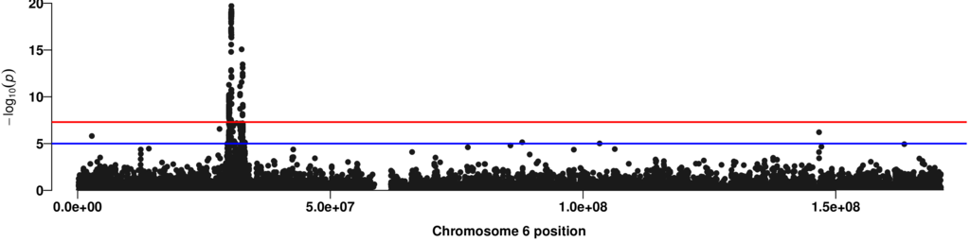
GENETIC ANALYSIS
Intergenic region
HLA region

Slide 27
DATA COLLECTION
Data collection, storing, and data sharing with other members of the consortium.

Slide 28
New analytic tools and how these could be leveraged by other members of the consortium

Slide 29
Areas seeking feedback from consortium members

Slide 30
GENOMICS OF NS TEAM: DUKE
PEDIATRICS
Rasheed Gbadegesin
Eileen Chambers
Rachel Cason
Megan Chryst-Stangl
SURGERY AND IMMUNOLOGY
Annette Jackson
Brian Shaw
BIOSTATISTICS AND STATISTICAL GENETICS
Cliburn Chan
Alejandro Ochoa
Amika Sood
COLLABORATORS
Debo Adeyemo NHGRI
NMDP Consortium
PNRC

